Slide 1
Information Retrieval
Lecturer: CHEN Qingcai (qingcai.chen@hit.edu.cn)
TA: 陈俊颖 吴洪发 杨新兰
Intelligent Computing Research Center,
Harbin Institute of Technology （Shenzhen）

Slide 2
“I believe there are reasons to think a Grand Theory of IR to be an unattainable goal - such a theory would have to encompass so many different aspects of retrieval, having to do for example with human cognition and behavior and the structure of knowledge, as well as with the statistical concepts that inform the probabilistic approach.”
有足够的理由使我相信去考虑（建立）大统一的信息检索理论是一个难以企及的目标—这样的理论需要囊括信息检索的各个不同方面，比如需要包括人类认知学、行为学、知识结构，以及用在概率方法中的统计学概念等等。
--Stephen Robertson
on 2000’s Salton Award lecture
Notes:
大统一理论（grand unified theories，GUTs）。试图用同一组方程式描述全部粒子和力(强相互作用、弱相互作用、万有引力、磁相互作用四种人类目前所知的所有的力)的物理性质的理论或模型的总称

Slide 3
Lecture 1 Introduction to Information Retrieval
References:
James Allan,University of Massachusetts Amherst
Amit Singhal, Google(R)

Slide 4
Outline
What is Information Retrieval?
Core idea of IR-related work
Notes:
Question: What’s your expectation for this course?

Slide 5
Questions before the course
What types of data had you processed?
What is a database management system? Had you learnt at least one DBMS?
What are your expectations for future SE?

Slide 6

What is Information Retrieval?
Quite effective (at some things)
Highly visible (mostly)
Commercially successful (some of them, so far)
But what goes on behind the scenes?
How do they work?
Is there more to it than the Web?
Up to 2019-09-1 $823.8 Billion of Mkt Cap
Up to 2019-09-1 $36.4 Billion of Mkt Cap

Slide 7
In this course, we ask…
What makes a system like Google or BING tick?
How does it gather information?
What tricks does it use?
Extending beyond the Web
How can those approaches be made better?
Natural language understanding?
User interactions?
What can we do to make things work quickly?
Faster computers? Caching?
Compression?
How do we decide whether it works well?
For all queries? For special types of queries?
On every collection of information?
What else can we do with the same approach?
Other media?
Other tasks?

Slide 8
Tasks beyond document retrieval
Question answering
Agents (filtering, routing)
Recommender systems
Automatic organization (e.g., clustering)
Cross-language retrieval
Leveraging XML and other Metadata
Data and information mining
Knowledge management
Meta-search (multi-database searching)
Summarization
…

Slide 9
Comparing IR to databases
What’s the difference between DBM and IR?
Database/Data warehouse
SQL (Structured Query Language)
Information Retrieval

Slide 10
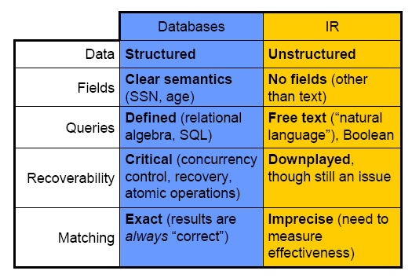
Comparing IR to databases

Slide 11
Sample Systems
IR systems
Inquery, Smart, Okapi, Lemur, Indri
Database systems
Oracle, Informix, Access
Web search and In-house systems
West, LEXIS/NEXIS, Dialog
Baidu, Bing, Sogou, AltaVista, Excite, Yahoo, Google, Dianping
HotBot, Direct Hit, …
Ask Jeeves
eLibrary, GOV.Research_center, Inquira
And countless others...

Slide 12
Outline
What is Information Retrieval?
Core idea of IR-related work

Slide 13
Basic Approach to IR
Most successful approaches are statistical
Directly, or an effort to capture and use probabilities
Why not natural language understanding?
i.e., computer understands documents and query and matches them
State of the art is brittle in unrestricted domains
Can be highly successful in predictable settings
Medical or legal settings with restricted vocabulary
Could use manually assigned headings
e.g., Library of Congress headings, Dewey Decimal headings
Human agreement is not good
Hard to predict what headings are “interesting”
Expensive

Slide 14
Relevant(相关) Items are Similar(相似)
Much of IR depends upon idea that
similar vocabulary → relevant to same queries
Usually look for documents matching query words
“Similar” (相似性) can be measured in many ways
String matching/comparison
Same vocabulary (词汇) used (?)
Probability that documents arise from same model
Same meaning of text
Notes:
Relevance is not so easy to measure.
Similar may not always means relevant: e.g. 哈工程与哈工大
What’s the exact meaning of “same vocabulary used”? Considering about the frequency distribution?

Slide 15
“Bag of Words” (词袋)
An effective and popular approach
Compares words without regard to order
Example 1: consider reordering words in a headline……
Random: beating takes points falling another Dow 355
Alphabetical: 355 another beating Dow falling points
“Interesting”: Dow points beating falling 355 another
Actual: Dow takes another beating, falling 355 points

Slide 16
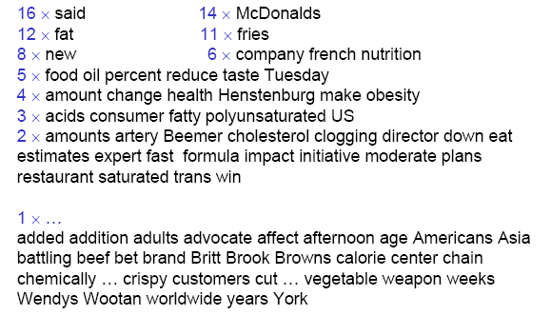
Example 2: What is this about?

Slide 17
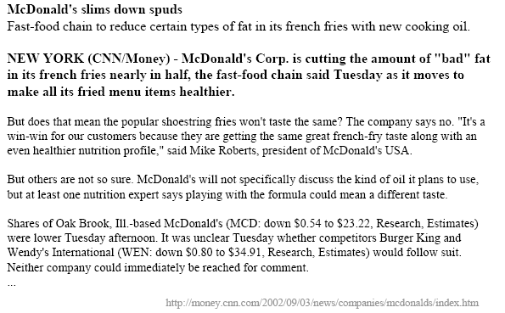
Example 2(Cont’d) The original text (the start)

Slide 18
The Point from Example 2
Basis of most IR is a very simple approach
find words in documents
compare them to words in a query
this approach is very effective!
Other types of features are often used
phrases
named entities (people, locations, organizations)
special features (chemical names, product names)
difficult to do in general, especially in Chinese; usually require hand building
Focus of research is on improving accuracy, speed
…and on extending ideas elsewhere

Slide 19
Simple flow of retrieval process
User
Interface
Text
user need
Text
Offline Processing
Text Operations
logical view
logical view
Query
Operations
DB Manager
Module
Indexing
user feedback
query
inverted file
Searching
Index
retrieved docs
Text
Database
Ranking
ranked docs
Notes:
备注：第一堂课通常就介绍到这里，然后再简单了解一下课程的政策、成绩分配、课程大纲就可以了；其他内容由大家自学

Slide 20
Conclusion
Information Retrieval?
Indexing, retrieving, and organizing text by probabilistic or statistical
techniques that reflect semantics without actually understanding
Search engines
Core idea
Bag of words captures much of the “meaning”
Objects that use vocabulary the same way are related

Slide 21
Homework 1
1. 调研并列出至少3个重要的信息检索国际期刊；列出3个信息检索领域的重要国际会议并给出相应官方网址、大概的会议重要日期、论文主要领域
2. 列出你最常用的搜索引擎，并给出其优点和缺点的简要描述
提交时间：2021.07.04，17:00前
提交方式：email、qq
文件标题格式（严格遵从，否则可能会影响统计）:
IR-HW01-[姓名]-[学号].doc

Slide 22
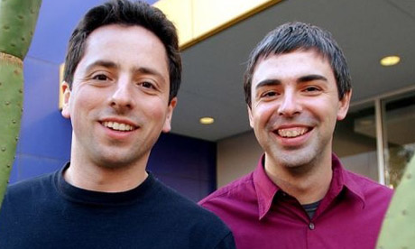
Google^{(R)} Fans......

Slide 23
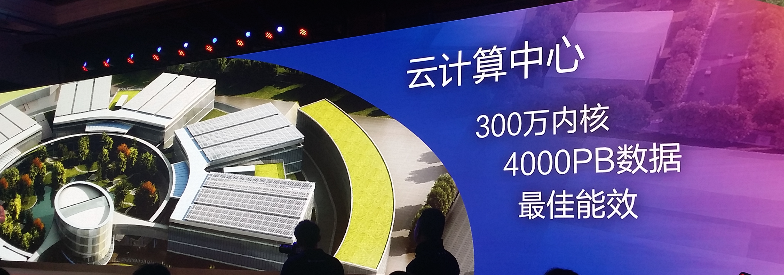

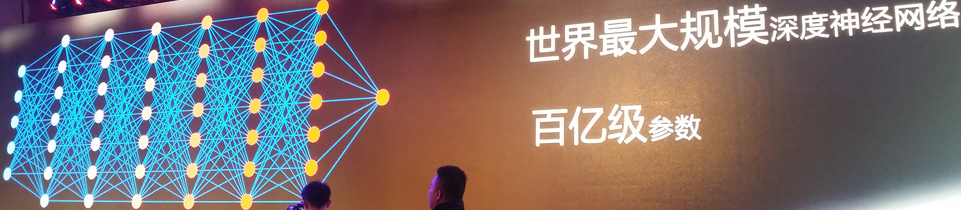
Baidu Brain
Notes:
We hope that Baidu’s Brain may change the situation of NLU! Baidu just spend 4.6Billion RMB in construction their computing center.

Slide 24

作业提交邮箱：
ir_hitsz@163.com
ir_hitsz@163.com

